Slide 1
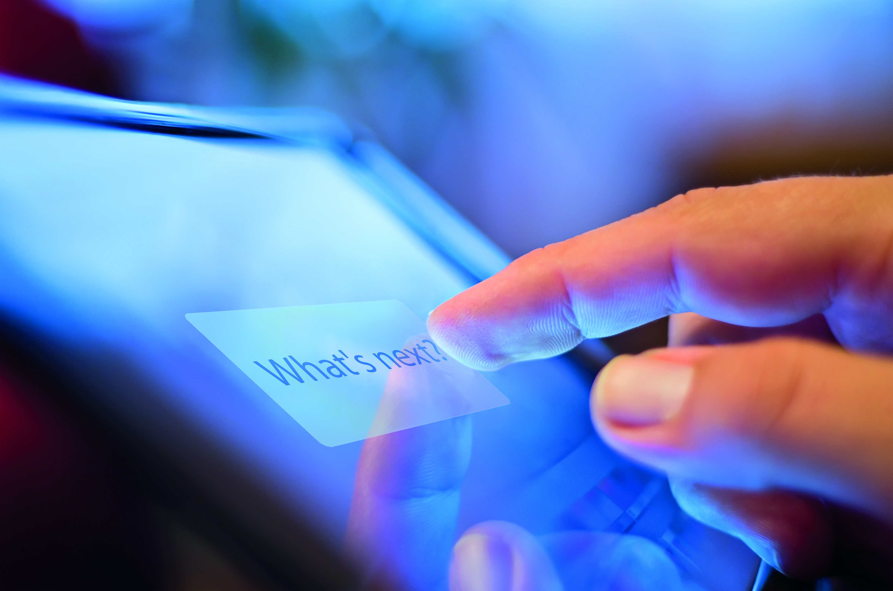


Preliminary Work – PhD Topic

Slide 2

Targeted projects/Use cases in this study
Introduce projects specifications
Discuss features and current competition
Discuss use cases around them
Present the data and data models
Discuss the added value of enriching the model with linked data
Apollo
KOF
Other
Panorama

Slide 3
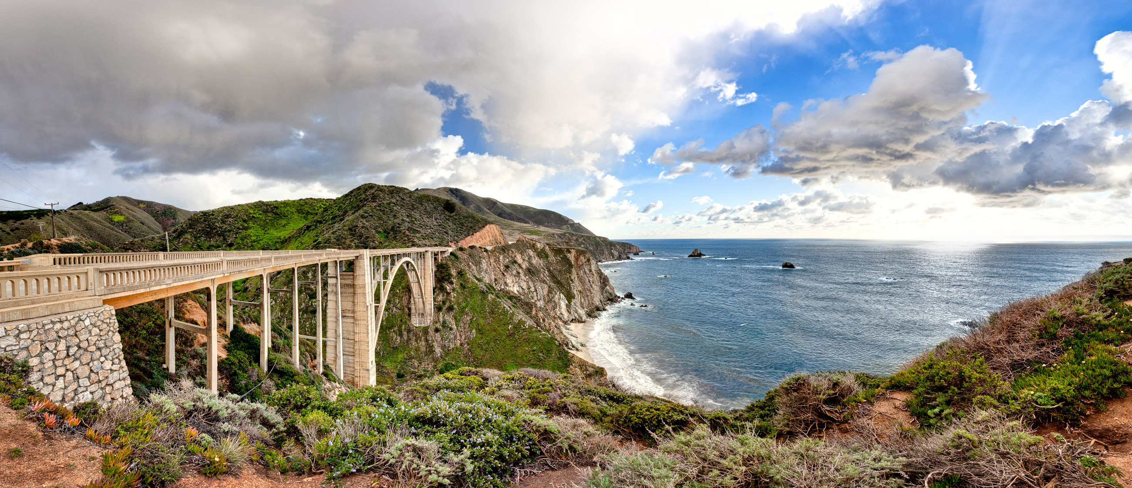
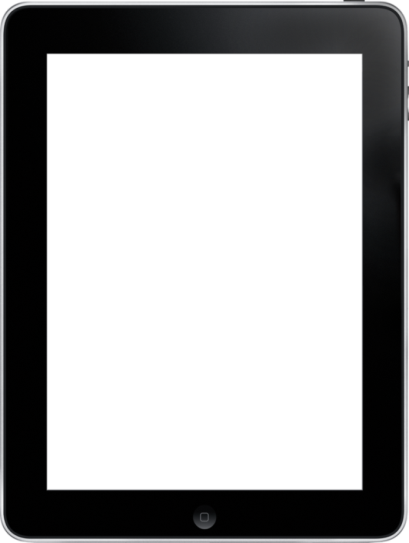
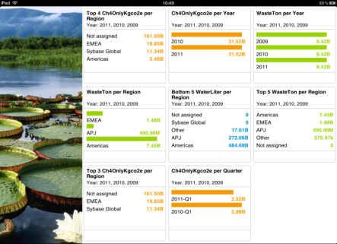

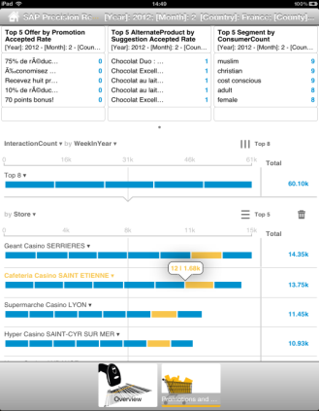
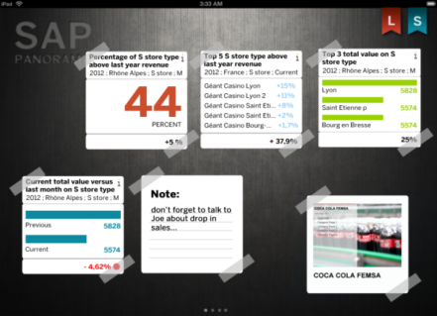
Panorama
Panorama is a self-service, real-time dashboarding mobile solution for business users, leveraging LAVA design principles as self-service enabler, Analytics on Demand (AoD), HANA Views and Data Specification Language (DaSL) to easily create and consume powerful analytic computations running at HANA speed .
https://portalpanoramaaod.prod.jpaas.sapbydesign.com/panorama/?sap-ui-xx-test-mobile=true&sap-ui-xx-fakeOS=ios
Demo

Slide 4

SAP Precision Retailing (Apollo)
SAP Precision Retailing (SPR) is a new cloud-based solution, powered by SAP HANA that empowers companies to influence consumer shopping behavior at the point of decision by delivering relevant information including 1-to-1 personalized offers in real-time across multiple channels such as mobile phones, in-store kiosks, and e-commerce sites.
Possible contributions
Social Media profiles
Enhanced geo-location (points of interests)
Events and social activities
Augment with rich data about products (nutrition values, reviews …etc)
The approach
analyzing a consumer's profile, preferences and purchase history and correlating them with data on shopping context, location and in-store product availability

Slide 5
KOF Use case
Special application of panorama technology stack on a specific data set for KOF with M2M integration
Hook up ERP to Cloud sync
Hook up M2M to Cloud sync
Create Panorama dashboards
The core purpose is to analyze in real-time the content of each machine and plan optimally the refill of items depending on various conditions (from sales, to events nearby, to weather)
“Vending machines are the next big thing”

Slide 6
Shopping in the 21st Century
Shoppers are using their smartphones to make in-store experiences even better. Retailers have responded to the growing number of mobile shoppers by attracting consumers in two important ways.
"Many stores brought back layaway, extended deals, offered price matching and coupons"
Mobile Shoppers activities Using Smartphone and Tablets*
78%
63%
61%
45%
48%
56%
68%
53%
GPS to locate store
Check price
Research Item
Reading reviews
*http://blog.nielsen.com/nielsenwire/consumer/mobile-devices-empower-todays-shoppers-in-store-and-online/

Slide 7
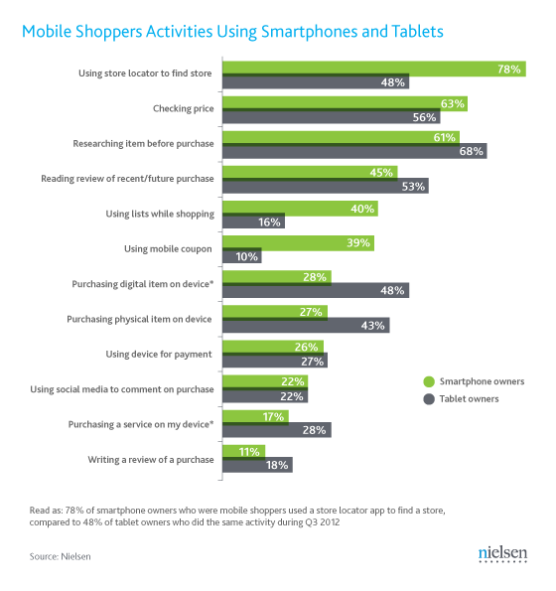
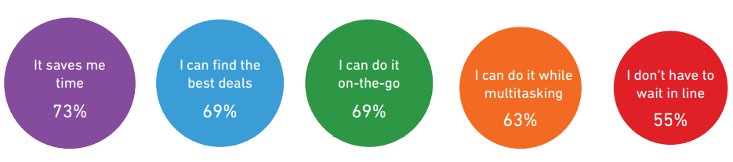

Slide 8
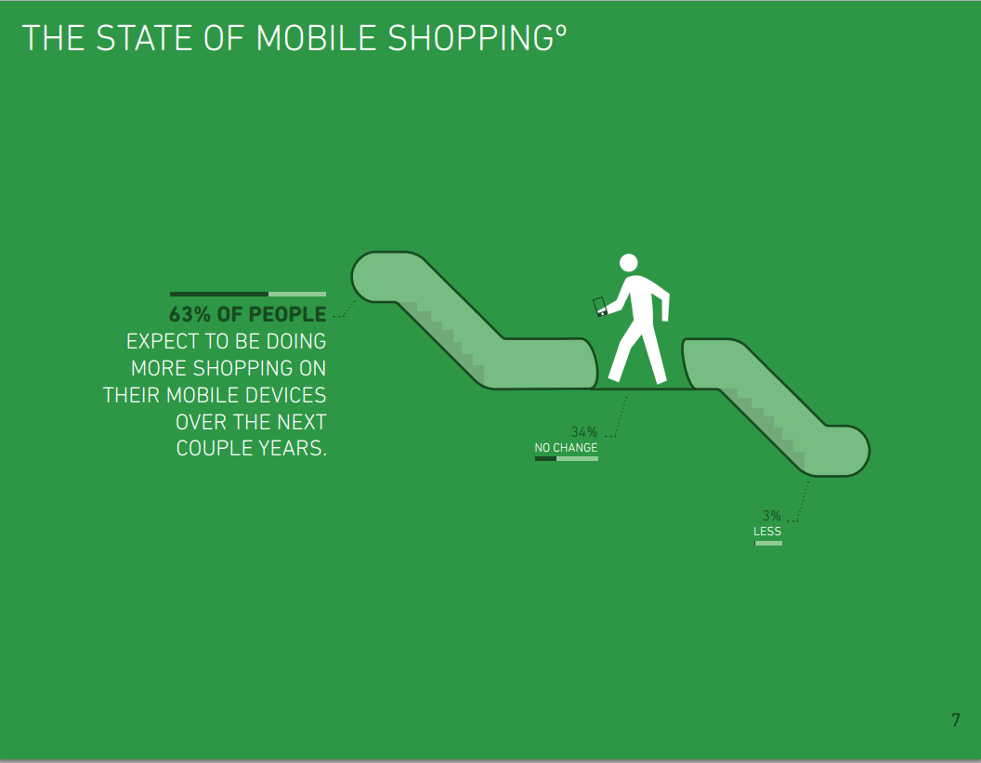

Slide 9

Use Cases
Geo-location
Points of Interests
Detecting nearby universities, parks and other POIs, this will help in pushing related offers based on the predicted populated area.
Checking -in
Checking in stores like foursquare will allow to earn points and badges and can result in rewards and loyalty points.
Users profiling
Location reflects the potential customers profile, in respect to gender, age … etc. i.e if a university is nearby then a student crowd is anticipated around lunch times, in the scholar year … etc.
Religion or ethnicity as well, as we can tell if a certain food requirements is required to match the nearby population requirements.
52% of all 20-29 year-olds cite smartphones as a favorite purchasing platform — significantly more than the 37% of 40-59-year-olds who prefer to purchase via smartphone

Slide 10

Use Cases
In-store Maps
Product catalogue When a product is selected, whether from a pre-populated list or as a recommended item .. etc. then the user should be able to visualize the location of the item in the store and maybe provide simple navigation
Optimize shopping experience I If the store allow to monitor traffic, populated areas can be highlighted (heat map) and a suggested shopping order is suggested so that congestion is avoided to shorten the time to pick products, and notify where is the best aisle to check out
Customer Rewarding Knowing shopping pattern can allow us to predict where certain customers can be in the store, i.e example taken from Casino; a store manager might pay a visit for “loyal” customers
Optimize shopping experience II Calculate check out for customers and how efficient the tellers are, calculate how holidays, seasons can affect the overall time spent and the amount of products bought, for example will a customer buy less times in case the store was full compared to previous experiences.
Push Alerts alerting the user when he walks approaches a product that has special offers in, have a store map with products and offers plotted … etc.

Slide 11

Use Cases
Health and Nutrition
Extra Details Provide extra information about a certain product, whether it was nutritional values or simple information about basic ingredients
Health Meter Suggesting how healthy the scanned product is and provide metrics. Depending on the user profile as well we can directly highlight if the current scanned product is recommended and give it a health score. The user will then evaluate a set of similar products based on the health/value scores
Going Healthy Upon scanning a product, push offers or notifications about similar product that can be healthier if it fits the users profile
Better Reporting relate nutritional values with sales to predict when certain products sell more (healthier products near summer as people might want to watch their weight then … etc. )
https://play.google.com/store/apps/details?id=com.fooducate.nutritionapp

Slide 12
Use Cases
Social Networks
Push Offers Aggregating offers and pushing them to and from social networks, taking advantage of Groupon and similar websites for example, allow of comparing offers and sending aggregated notifications in micro blogging networks
User Profiling
Mine the users social footprint using his current activities in the current social networks, the user either logs in and links these networks or data is retrieved if possible from his public profiles; afterwards the streams of data weather it was interactions with other users or pages and brands, photos collection … etc and build a profile that can help in pushing specific offers. Moreover, notification if approaching birthdays or events from these networks
Events and Activities Having a list of nearby events and activities can help in predicting the anticipated products to be consumed and help in better management of stock
Product Reviews and Feedback Upon scanning a product reviews mined from the web and social networks can be pushed, this can help the user to pick the best item that the community or similar users found suitable

Slide 13

Use Cases
Others
Weather Access to historical and current weather conditions can allow infer patterns related to seasons, heat … etc. Specialized offers can be pushed to accommodate anticipated or current weather conditions i.e offers on cold beverages in summer or heavy clothing when winter is approaching
Time Keeping track of shopping times and seasons can allow predict times and days people shop in most, to check in the stock … etc. Anticipate holidays and special seasons
History Mining previous shopping experiences in order to allow faster optimized experience i.e one click buying if it is online or quickly predict alternatives for elements not found and building of customized lists

Slide 14
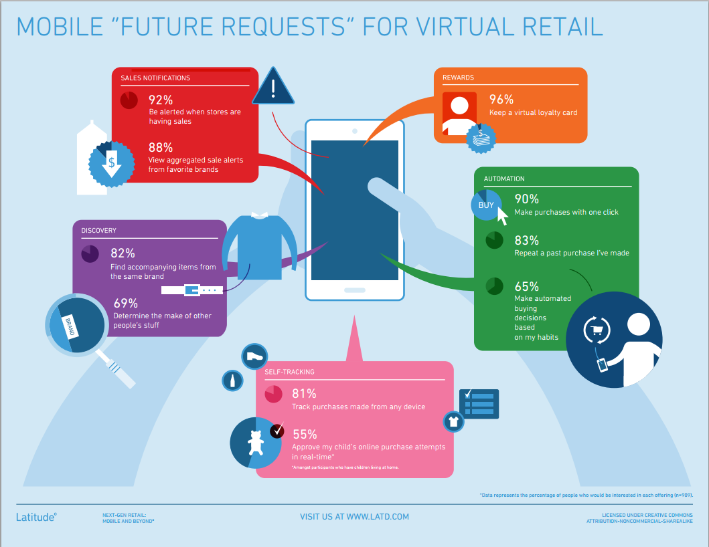

Slide 15
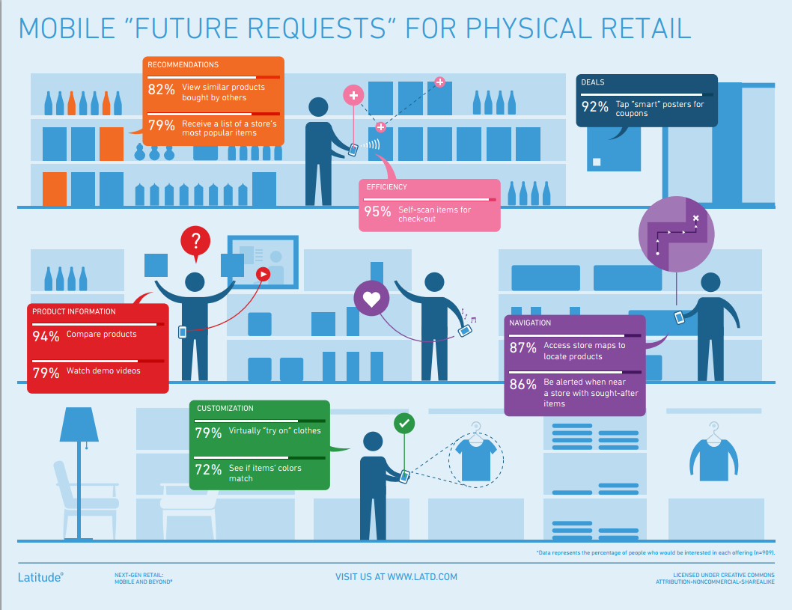

Slide 16
Schema Partitions
Consumer
Retailer
Interaction History
Core Schema (Products, Promotions)
Orchestration and API
Apollo

Slide 17
Schema Partitions - Details
Core Schema (Products/Promotions)
Product details and descriptions
Retailer market segments and offers information
Store locations, cross products
Retailer
Product inventory and pricing details
Products catalogues and store assortments
Sponsorship of university chairs
Consumer
User specific information
User preferences and shopping lists
Interaction / History
System events log
Consumer events (add to list, accept/reject deal … etc.)
Orchestrator and API
Application specific tables that do not contain business data (session info, table lookups … etc.)

Slide 18
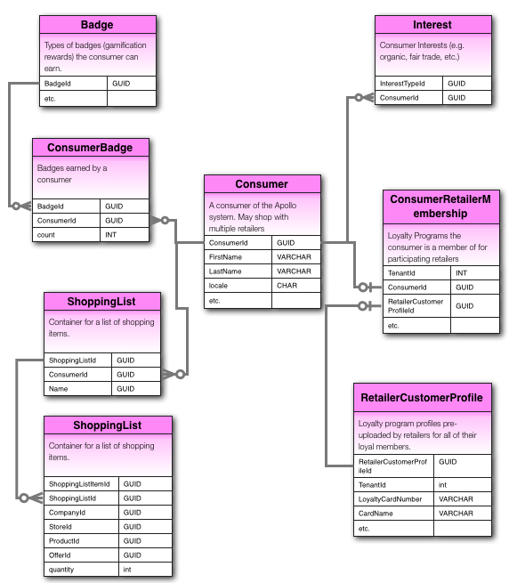
Consumer Schema
Key Tables:
Consumer
ConsumerAddress
ConsumerInterest
ConsumerPrivacyLevel
ConsumerSettings
DefaultStore (each consumer has zero or one per retailer)
ShoppingList
ShoppingListItem
ConsumerBadge
Badge
BadgeLang
ConsumerRetailerMembership (consumers who have scanned their loyalty cards to link them to apollo)
RetailerConsumerProfile (retailer uploaded loyalty card participant info)

Slide 19
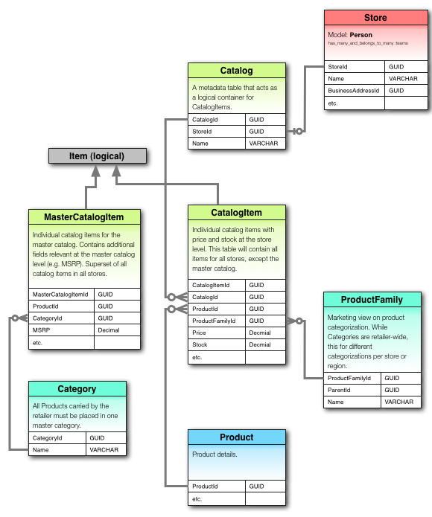
Retailer Schema
Key Tables:
Catalog
Category
MasterCatalogItem
CatalogItem (store catalog items)
ProductFamily

Slide 20
Enriching with External Data
Geo-location
OpenStreetMap
Google Maps
DataPlace (POIs and demography)
POIs Dump
GeoWordnet
LinkedGeoData
Nutrition/Products
Nutritionix
Factual
ProductDB
Linked Open Commerce
Other
Wunderground (Weather)
Social APIs
EventMedia
Amazon (Product reviews and recommendation)

Slide 21
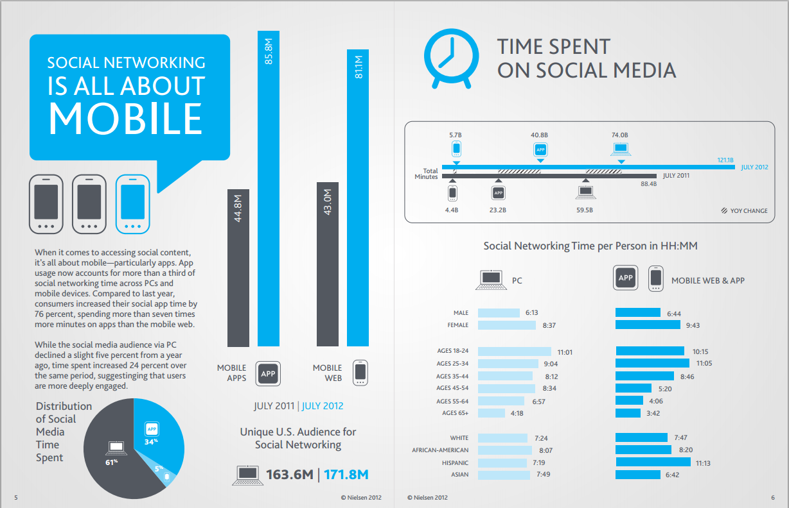

Slide 22
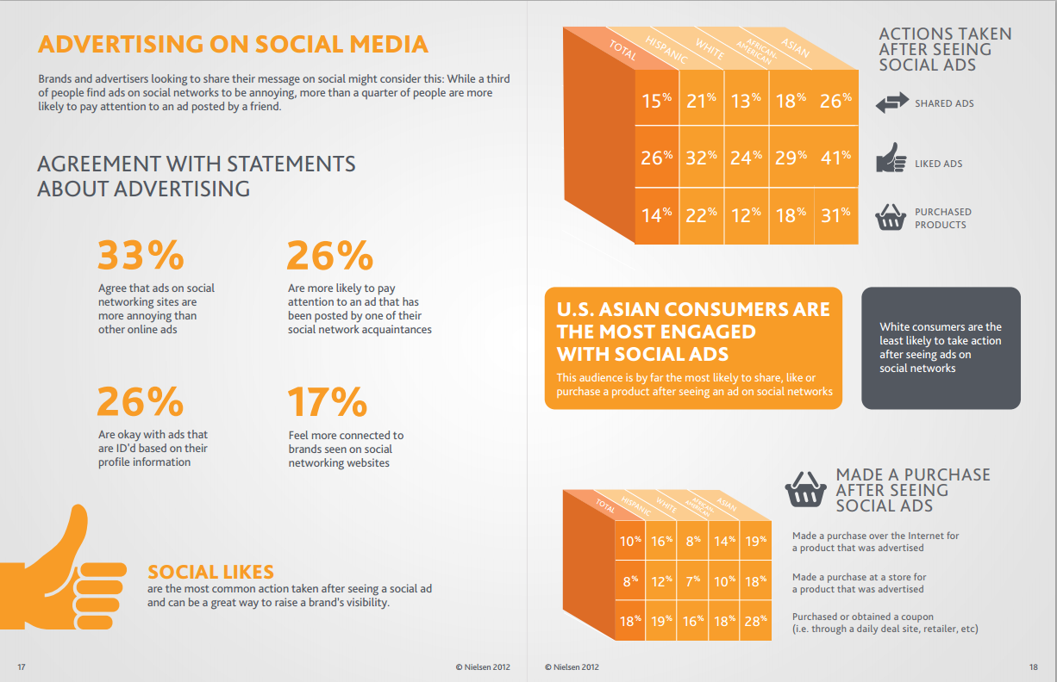

Slide 23
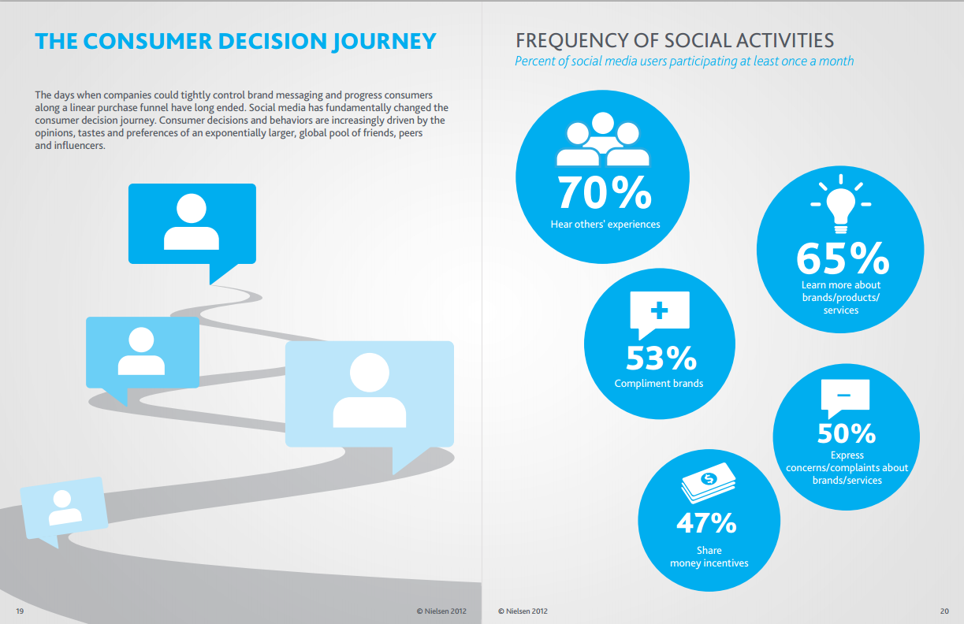

Slide 24
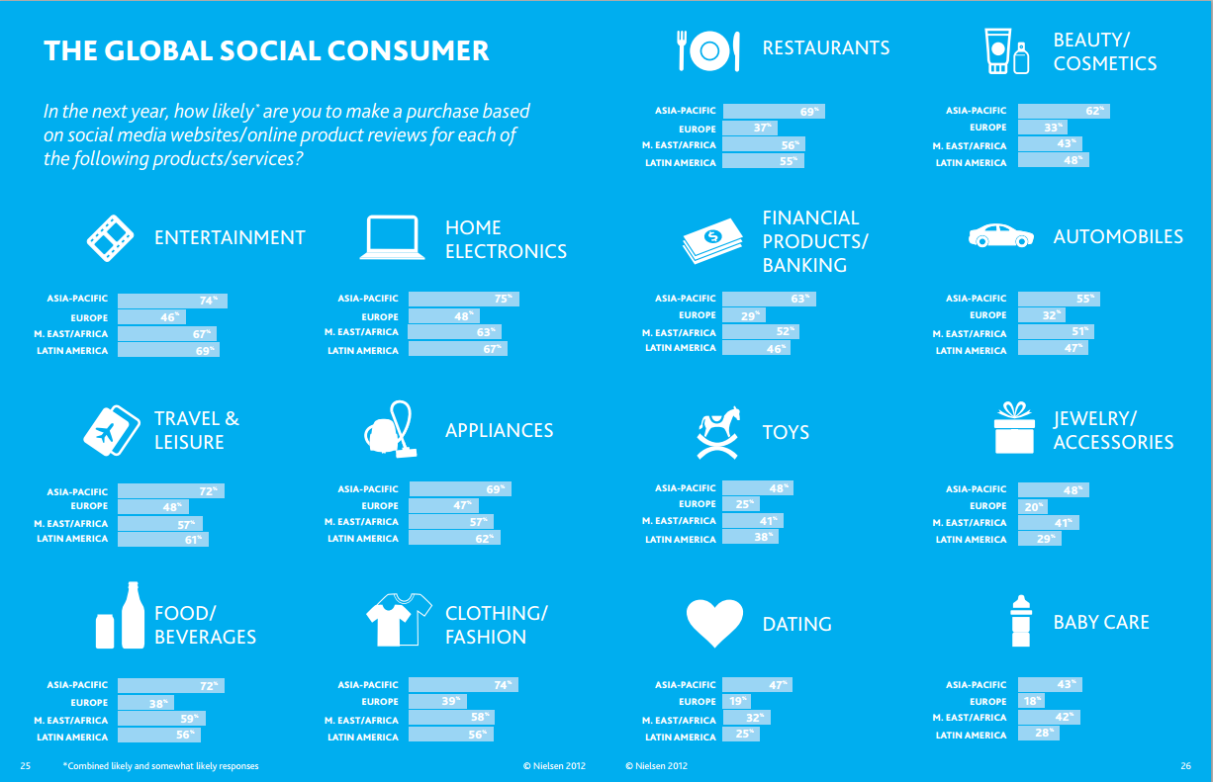

Slide 25
Social Media Profiling
Scouting
Linking Profile
Mining
Refining
Exploration
Matching
Historical
Predictive
Social Footprint
Common Social Model
Identifying targeted platforms
Extracting Interests
Search, mine and map social profiles
Shared Social linked model
Adaptive weighted model for social networks
Data Mining Techniques

